Slide 1
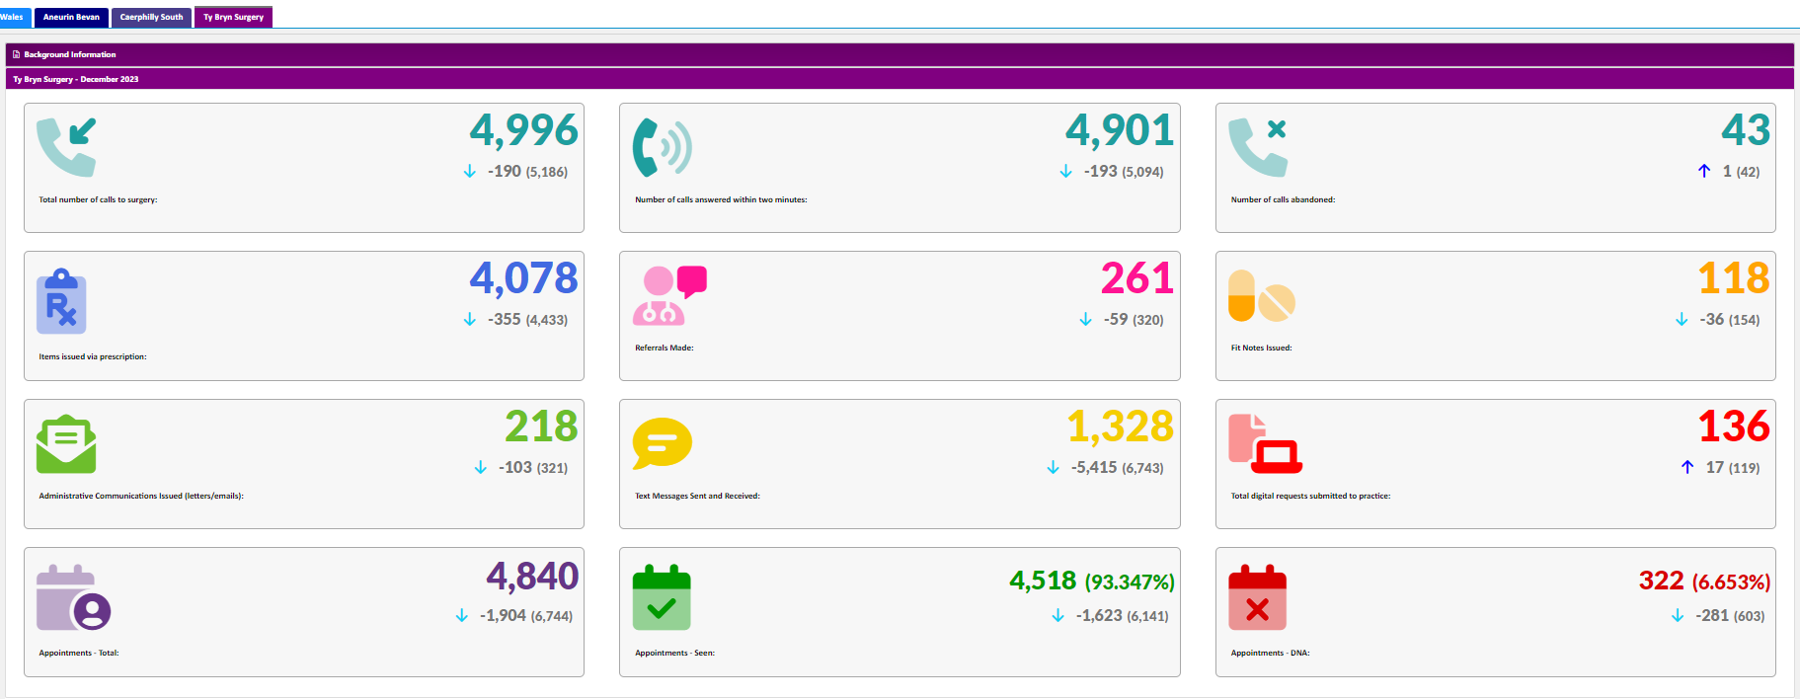
December 2023 Activity Ty Bryn Surgery

Slide 2
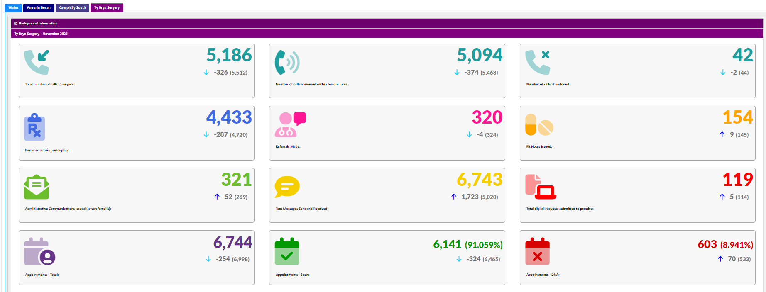
November 2023 Activity Ty Bryn Surgery

Slide 3
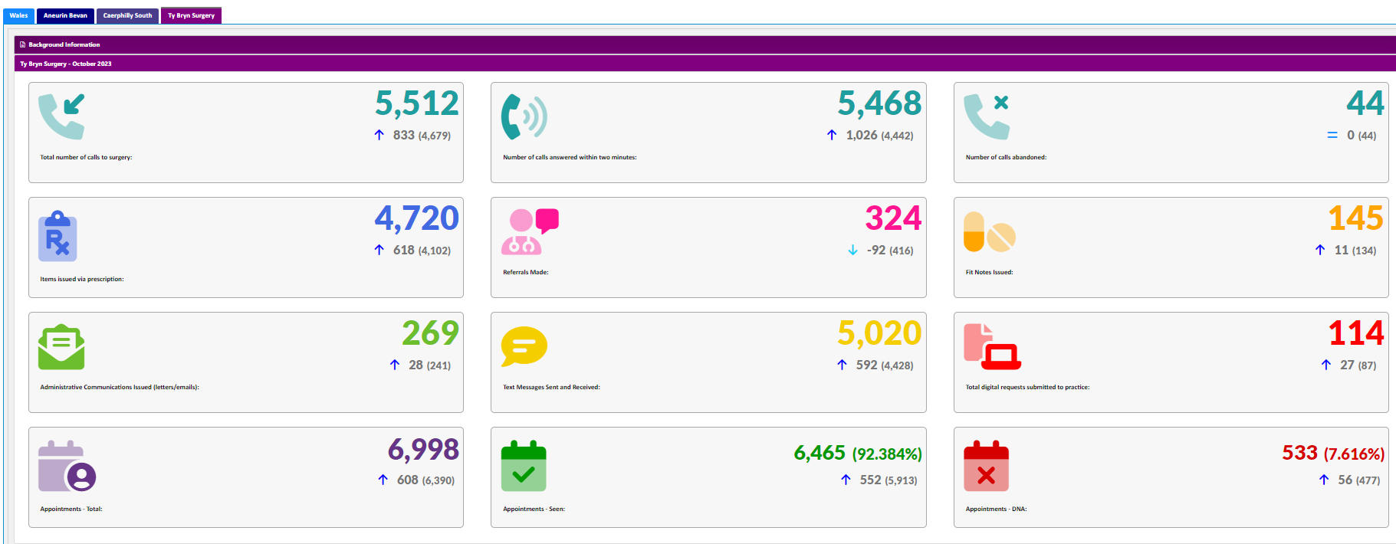
October 2023 Activity Ty Bryn Surgery

Slide 4
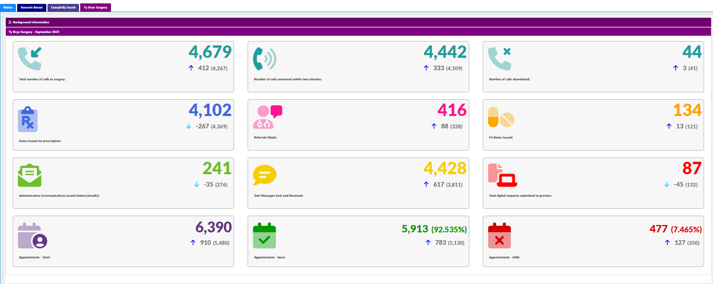
September 2023 Activity Ty Bryn Surgery

